Slide 1
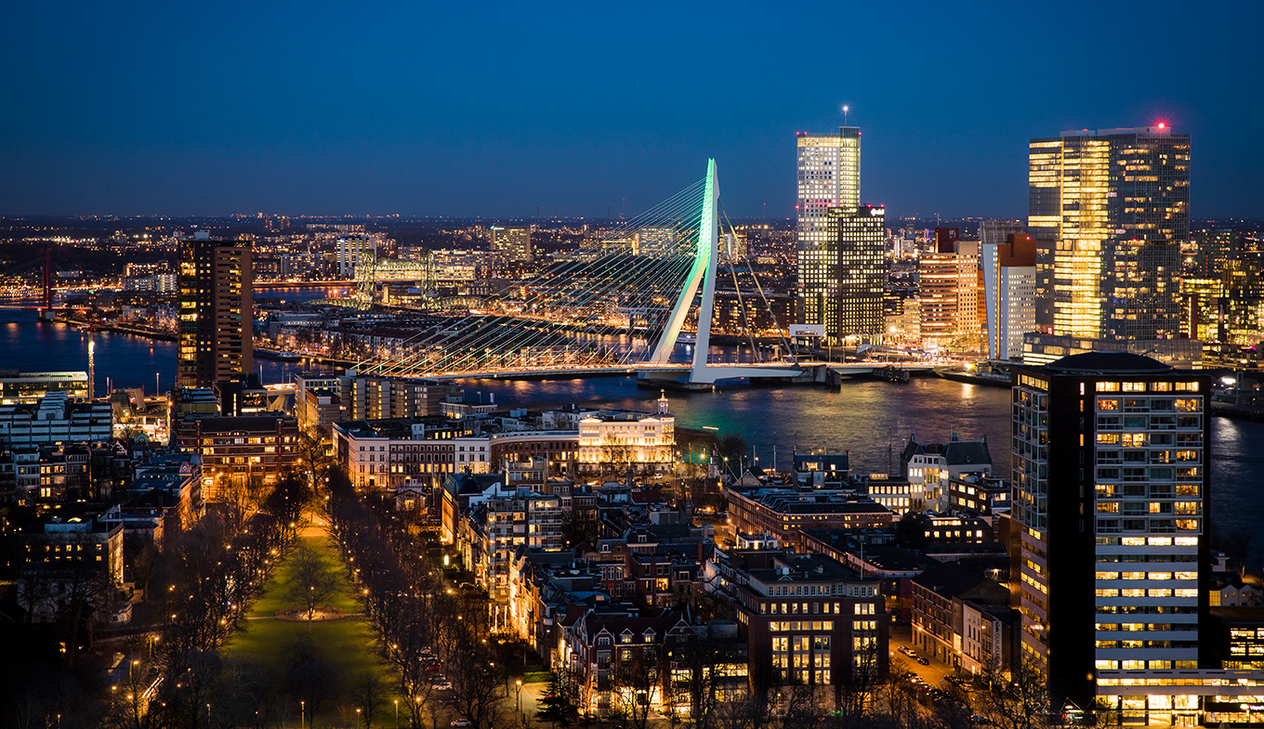
The battle of the neighbourhoods
Where to live in Rotterdam, the greatest city of Holland
René Kluijtmans

Slide 2
Introduction
Rotterdam is not the best known city from Holland
Most tourists go to Amsterdam
Politically, The Hague is best known
However, Rotterdam has a lot to offer
After being bombed in WW II, the city was completely rebuild
Nowadays, Rotterdam is a very modern city
In addition, all facilities you can think of are there!

Slide 3
Business Problem
I’m looking for a new house, within a few months I want to move
I’ve always lived in villages near Rotterdam, but now I want to go BIG!
As I adore Rotterdam, I really want to live in this city.
However, where in Rotterdam is the best place to live?
I do know the city quite good, but really don’t know which neighbourhood is the best
Luckily, I can now use my data science and machine learning skills to provide myself an answer.

Slide 4
Data Description
For this project I will use the data of neighbourhoods in Rotterdam
On WikiPedia, I’ve found a page which I can use perfectly
https://en.wikipedia.org/wiki/Districts_and_neighbourhoods_of_Rotterdam
Data will be cleaned and then used for my research
Longitude and latitude data will be used to use as input for searching venues
The venues in the neighbourhood will lead to clusters
Clusters will determine what neighbourhoods will be the best to buy a house

Slide 5
Methodology
The following libraries have been used
Pandas, Numpy, Requests, Geopy, Nominatim, Matplotlib (for cm, pyplot and colors), Folium, Kmeans (from SciKit Learn)
With requests and pandas, webdata of neighbourhoods in Rotterdam have been scraped
Longitude and Latitude have been added with Geopy and Nominatim
Foursquare API was used for searching venues at each neighbourhood
Folium was used to plot both the neighbourhoods as clusters
K-Means Clustering method was used to create clusters (n = 5)

Slide 6
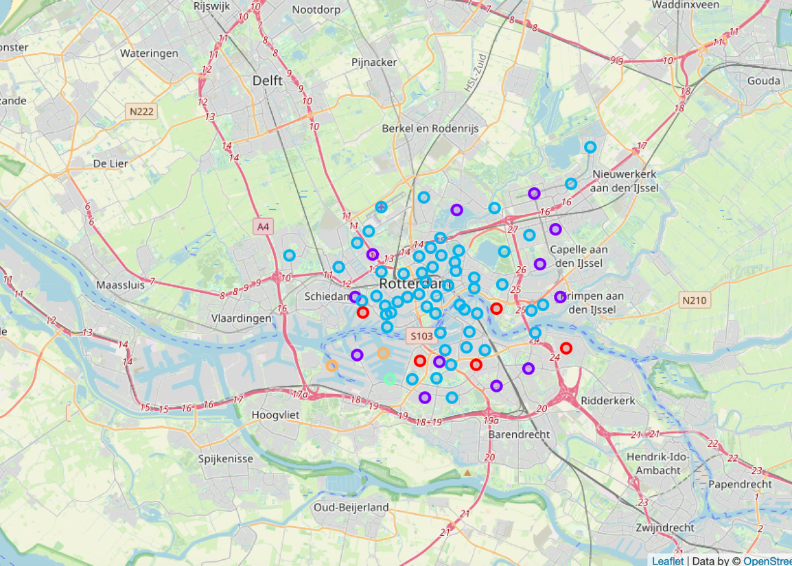
Results (Clusters on Map)
Cluster 1 seems basic (see next slide)
Cluster 2 has all the things you look for in a city!
Cluster 3 and 4 seem more water/harbor centered, with a lot of food possibilities
Cluster 5 is especially close to tram and bus stations

Slide 7
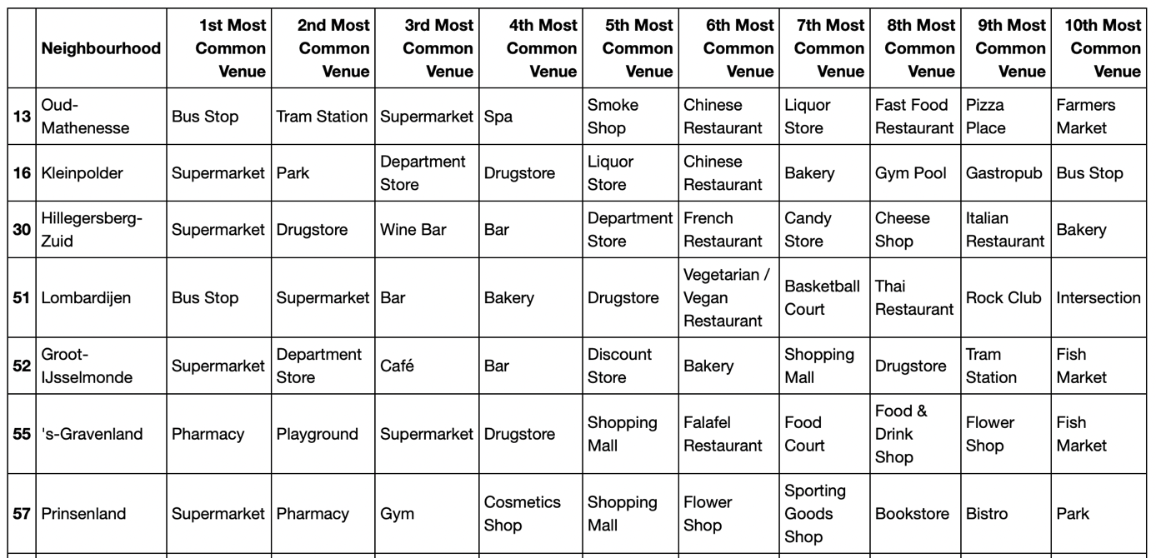
Results (Cluster 1)

Slide 8
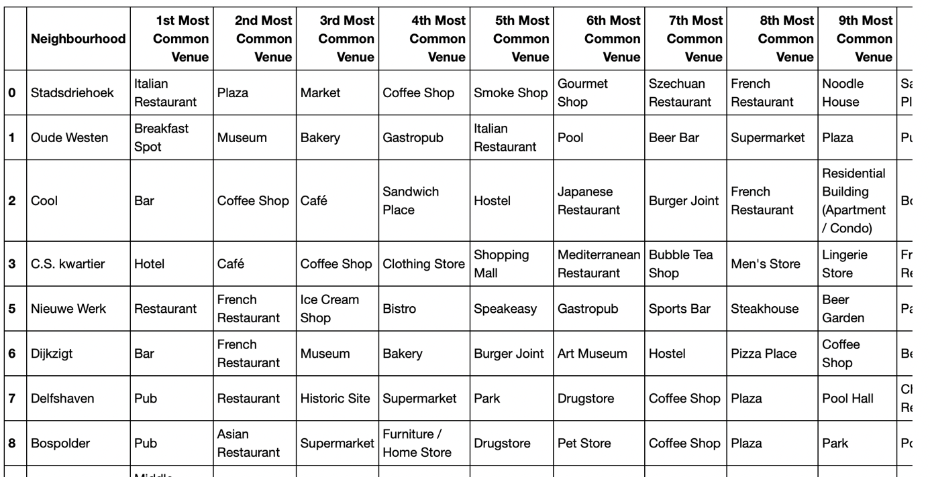
Results (Cluster 2)

Slide 9
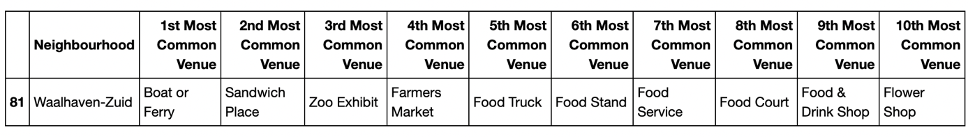
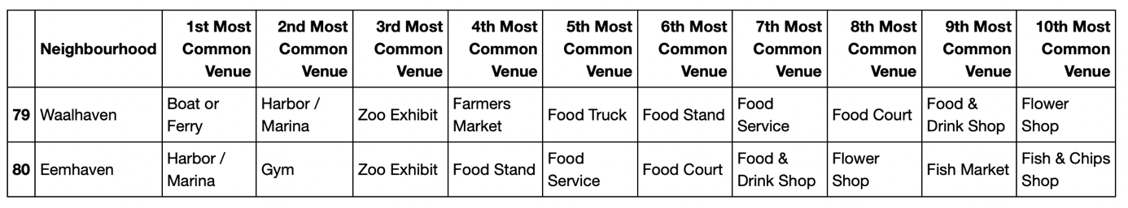
Results (Cluster 3 & 4)

Slide 10
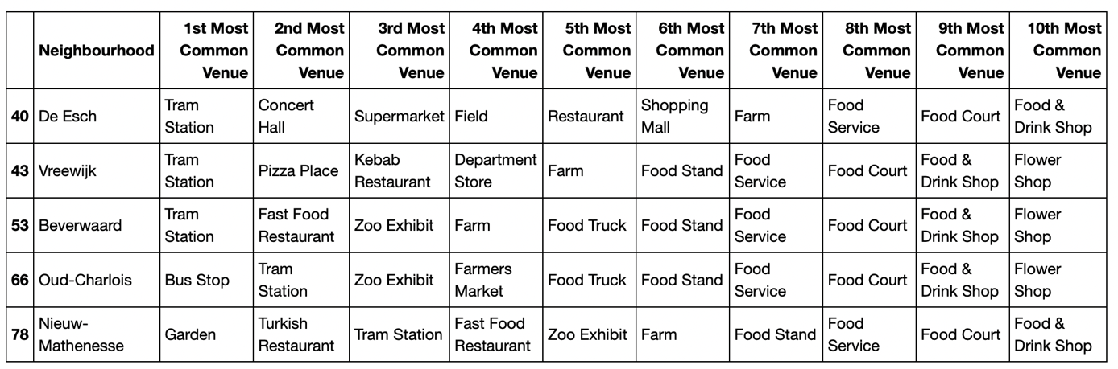
Results (Cluster 5)

Slide 11
Discussion
After examining all clusters and knowing my personal wish, conclusion is….
Cluster 2 is the cluster with the best neighbourhoods for my new
Cluster 2 also exists of the most neighbourhoods and looking to the map, it’s also the most centralized cluster of all 5.
The information in this model could be seen as general and not too specific
However, I really think it can help people to decide where to live in a certain city.
For Rotterdam, I would be very happy to apply my model to anyone that is looking to live in the city of Rotterdam.
In addition, I would also be very happy to keep continuing improving this model, to give the best advice.
The K-Means Clustering method has again shown that it has really an added value in machine learning.
I really enjoyed learning all the machine learning methods and was able to apply 1 in my final project.

